Slide 1
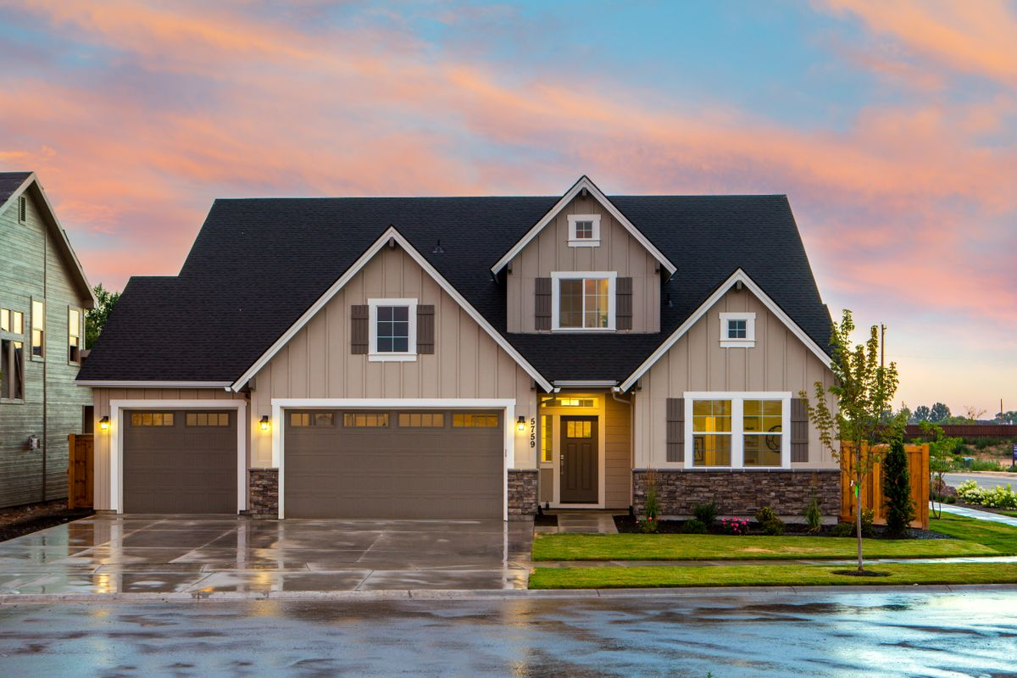
PRESENTED BY
Brittany Morales
SunCoast Realty Group
License SL3294187
OFFERED AT
$525,000
12508 Westchester Estates Dr
Tampa, FL 33626 | Westchase
4 BR | 3 BA | 2,760 SqFt Screened Pool | 3-Car Garage

Slide 2
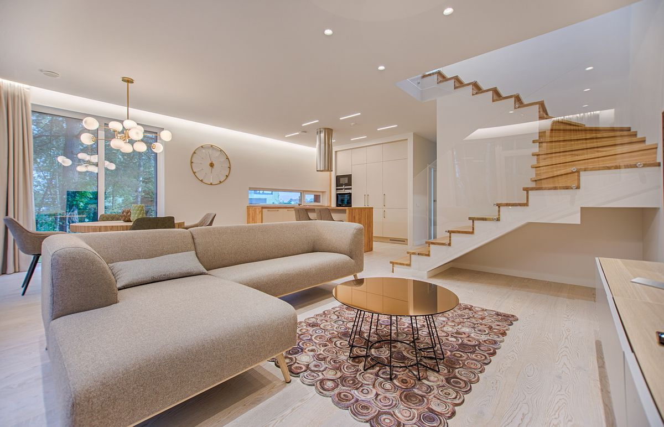
Property Highlights
12508 Westchester Estates Dr, Tampa FL 33626
Kitchen
Quartz counters, oversized island, walk-in pantry. Opens to family room via sliding doors.
Living
Soaring ceilings, wide-plank floors, oversized windows. Natural light throughout.
Primary Suite
Spa bath with soaking tub, glass shower, dual vanities. Private wing.
Outdoor
Screened pool and paver lanai. Fenced yard. Pool opens to family room.
School Zone
Zoned for top-rated Westchase schools. Veterans Expressway access nearby.
Garage
Three-car tandem garage. Space for staging supplies, sports gear, storage.

Slide 3
Pricing Strategy
Comparable sales analysis | Recommended list price: $525,000
Pricing Rationale
Comparable sales range $518K to $531K for 4BR/3BA Westchase homes sold within 60 days.
At $525,000 the subject is priced at the market midpoint with room for negotiation while limiting days on market.
Pre-listing inspection confirms sale-ready condition. Pool, school zone, and 3-car garage justify top-of-range pricing.
Commission: 5% total (2.5% listing side).

Slide 4
Marketing and Exposure Plan
Photography | MLS | Social | Print | Digital | Open House
Professional Photography
Gabriela Santos, $250, 24-hour turnaround. Twilight set for premium appeal. Drone exterior.
MLS Listing
Full Stellar MLS entry within 24 hours of photography. Maximum field completion for search visibility.
Social Media
Instagram Reel of staging reveal. Open house countdown. TikTok neighborhood guide. 4,500+ followers.
Open House
October 17, 2:00 to 4:00 PM. Co-hosted by Diana Cruz. Cafecito and pastelitos served.
Email Blast
Mailchimp newsletter to 1,840 past clients and sphere. Just-listed announcement with photos.
Agent Network
Distributed to SunCoast network. Co-listing alert to Diana Cruz for referral leads.
Print Flyer
Just-listed flyer for neighborhood drop and open house sign-in table.
Online Syndication
Listing syndicates to Zillow, Realtor.com, and Homes.com through MLS.

Slide 5

YOUR AGENT
Why Choose Brittany
Brittany Morales
14 Years in Tampa
SunCoast Realty Group
Licensed 2012. Fourteen years of market fluency across South Tampa, Westchase, Seminole Heights, Channelside, and Hyde Park.
License SL3294187
(813) 555-0119
Self-Staged Listings
brittany.morales@Greenridertech.co
Every listing staged personally with Carlos Menendez. $1,200 to $2,500 budget. Faster closings, stronger offers.
Professional Photography
Gabriela Santos shoots every listing within 24 hours. Twilight photography for premium properties.
Proven Social Reach
4,500 Instagram followers. Daily listing stories. TikTok neighborhood guides. Your listing reaches buyers where they search.
YTD Track Record
$1.83M closed in 2026 across 4 transactions. Personal best $4.2M in 2024. Full-time, high-volume agent.

Slide 6
Open House Plan
Saturday, October 17, 2026 | 2:00 to 4:00 PM | 12508 Westchester Estates Dr
Time | Action | Detail
1:00 PM | Setup | Open blinds, lamps on, pool screen open, thermostat 72. Sign-in tablet and flyers on island.
1:30 PM | Diana Cruz arrives | Co-hosts first hour. Covers guest flow while Brittany works kitchen and living areas.
1:55 PM | Refreshments set | Cuban cafecito station, pastelitos, bottled water. Fresh orchids kitchen and primary bath.
2:00 PM | Doors open | Greet every guest at door. Lead with kitchen island and pool lanai. Flyers available.
3:00 PM | Mid-house check | Text update on attendance. Flag hot leads for immediate HubSpot entry.
4:00 PM | Close and debrief | Collect sign-in tablet. Text all signed-in leads within 2 hours using Twilio template.
4:30 PM | Lead review | Prioritize Marcus Webb, Priya Anand, Dana Pruitt. Nguyens top priority if attended.

Slide 7
Financial Summary
Seller net estimate at $525,000 | 5% total commission
List Price
$525,000
Expected Sale Price
$510,000 - $525,000
Total Commission (5%)
$25,500 - $26,250
Listing Side (2.5%)
$12,750 - $13,125
Buyer Agent Side (2.5%)
$12,750 - $13,125
Estimated Title/Closing
$3,000 - $4,500
Estimated Seller Net
$481,000 - $507,000

Slide 8
Ready to list?
Brittany Morales
Let's talk through the timeline and get your home on the market.
SunCoast Realty Group
South Tampa | Est. 2012
(813) 555-0119 brittany.morales@Greenridertech.co @brittany.morales.homes | SunCoast Realty Group

